Slide 1

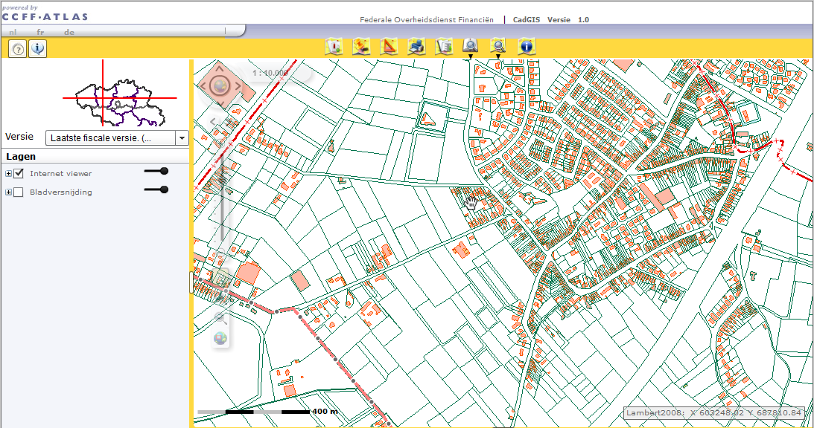
The belgian cadastre
Peculiarities and future challenges

Slide 2

Belgian Cadastre: context
Officially: Measurements and Assessments (Valuations) administration
Within the competence of the Belgian Federal Public Service Finance
Part of the General administration of Patrimonial documentation
Core business: organization of a large documentation as regards the patrimony, including real and personal property
Based in Brussels with 110 local offices at 27 different locations
Notes:
Our name perfectly mirrors our main activity, that is to say the organization of a large documentation as regards the patrimony, including the real (immovable) and the personal (movable) property, e.g. furniture, cars, jewels and other objects or money. We currently have 110 offices with about 1250 employees, which used to be 3000 about two decades ago. Due to a constant decrease in staff, economy measures and evolving automation and technology, we have been centralizing a great part of the tasks and closed down the smaller offices.

Slide 3

Belgian Cadastre: context
FPS Finance
General Tax Administration
Strategic Expertise and Support
Special Tax Inspectorate
Customs and Excise
Treasury
Administration of Patrimonial Documentation
8500
Tax Collection and Recovery Administration
3000
700
4000
3500
400
Notes:
The General administration of Taxes is mainly responsible for the income taxes (with respect to natural and legal persons, companies and non-residents) and the VAT. The Tax Collection and Recovery Administration then collects the taxes levied by the first administration. Because of the property tax on real estate we collaborate with those two administrations when it comes to collecting the levied property tax or to imposing fines for not declaring new builds or material changes in real estate.
The Special Tax Inspectorate's mission is to fight against serious and organized tax evasion, e.g. financial fraud and swindling.
The Customs authorities are in charge of protecting the society, promoting the international trade with the control of external borders and ensuring the security of the logistics chain. They secure the import duties, the excise duties and the VAT at importation.
The national Treasury manages of the State’s treasury, the public debt, the Royal mint of Belgium.
The Strategic Expertise and Support administration is responsible for drawing up, coordinating, implementing and following up the regulations for matters falling within the competence of the FPS Finance.

Slide 4
Belgian Cadastre: context
FPS Finance
General Tax Administration
Treasury
Patrimonial Documentation
Customs and Excise
Legal Security
Patrimonial Services
Measurements and Assessments
Information Exchange and Collection
Strategic Expertise and Support
Tax Collection and Recovery Administration
Special Tax Inspectorate
Notes:
Last years we have been moving towards a legal Cadastre, which means that for example, in order to determine a parcel’s status on a certain moment, we look at the rights of ownership on that parcel and not its material status. Therefore, we closely collaborate with the Legal Security administration.
The Legal Security administration is the Belgian Land registry; they publish the public officers’ deeds as regards real estate and mortgages and collect the estate and mortgage duties.
The administration of Patrimonial Services sells and buys real estate for the public authorities, is in charge of expropriations, etc.

Slide 5
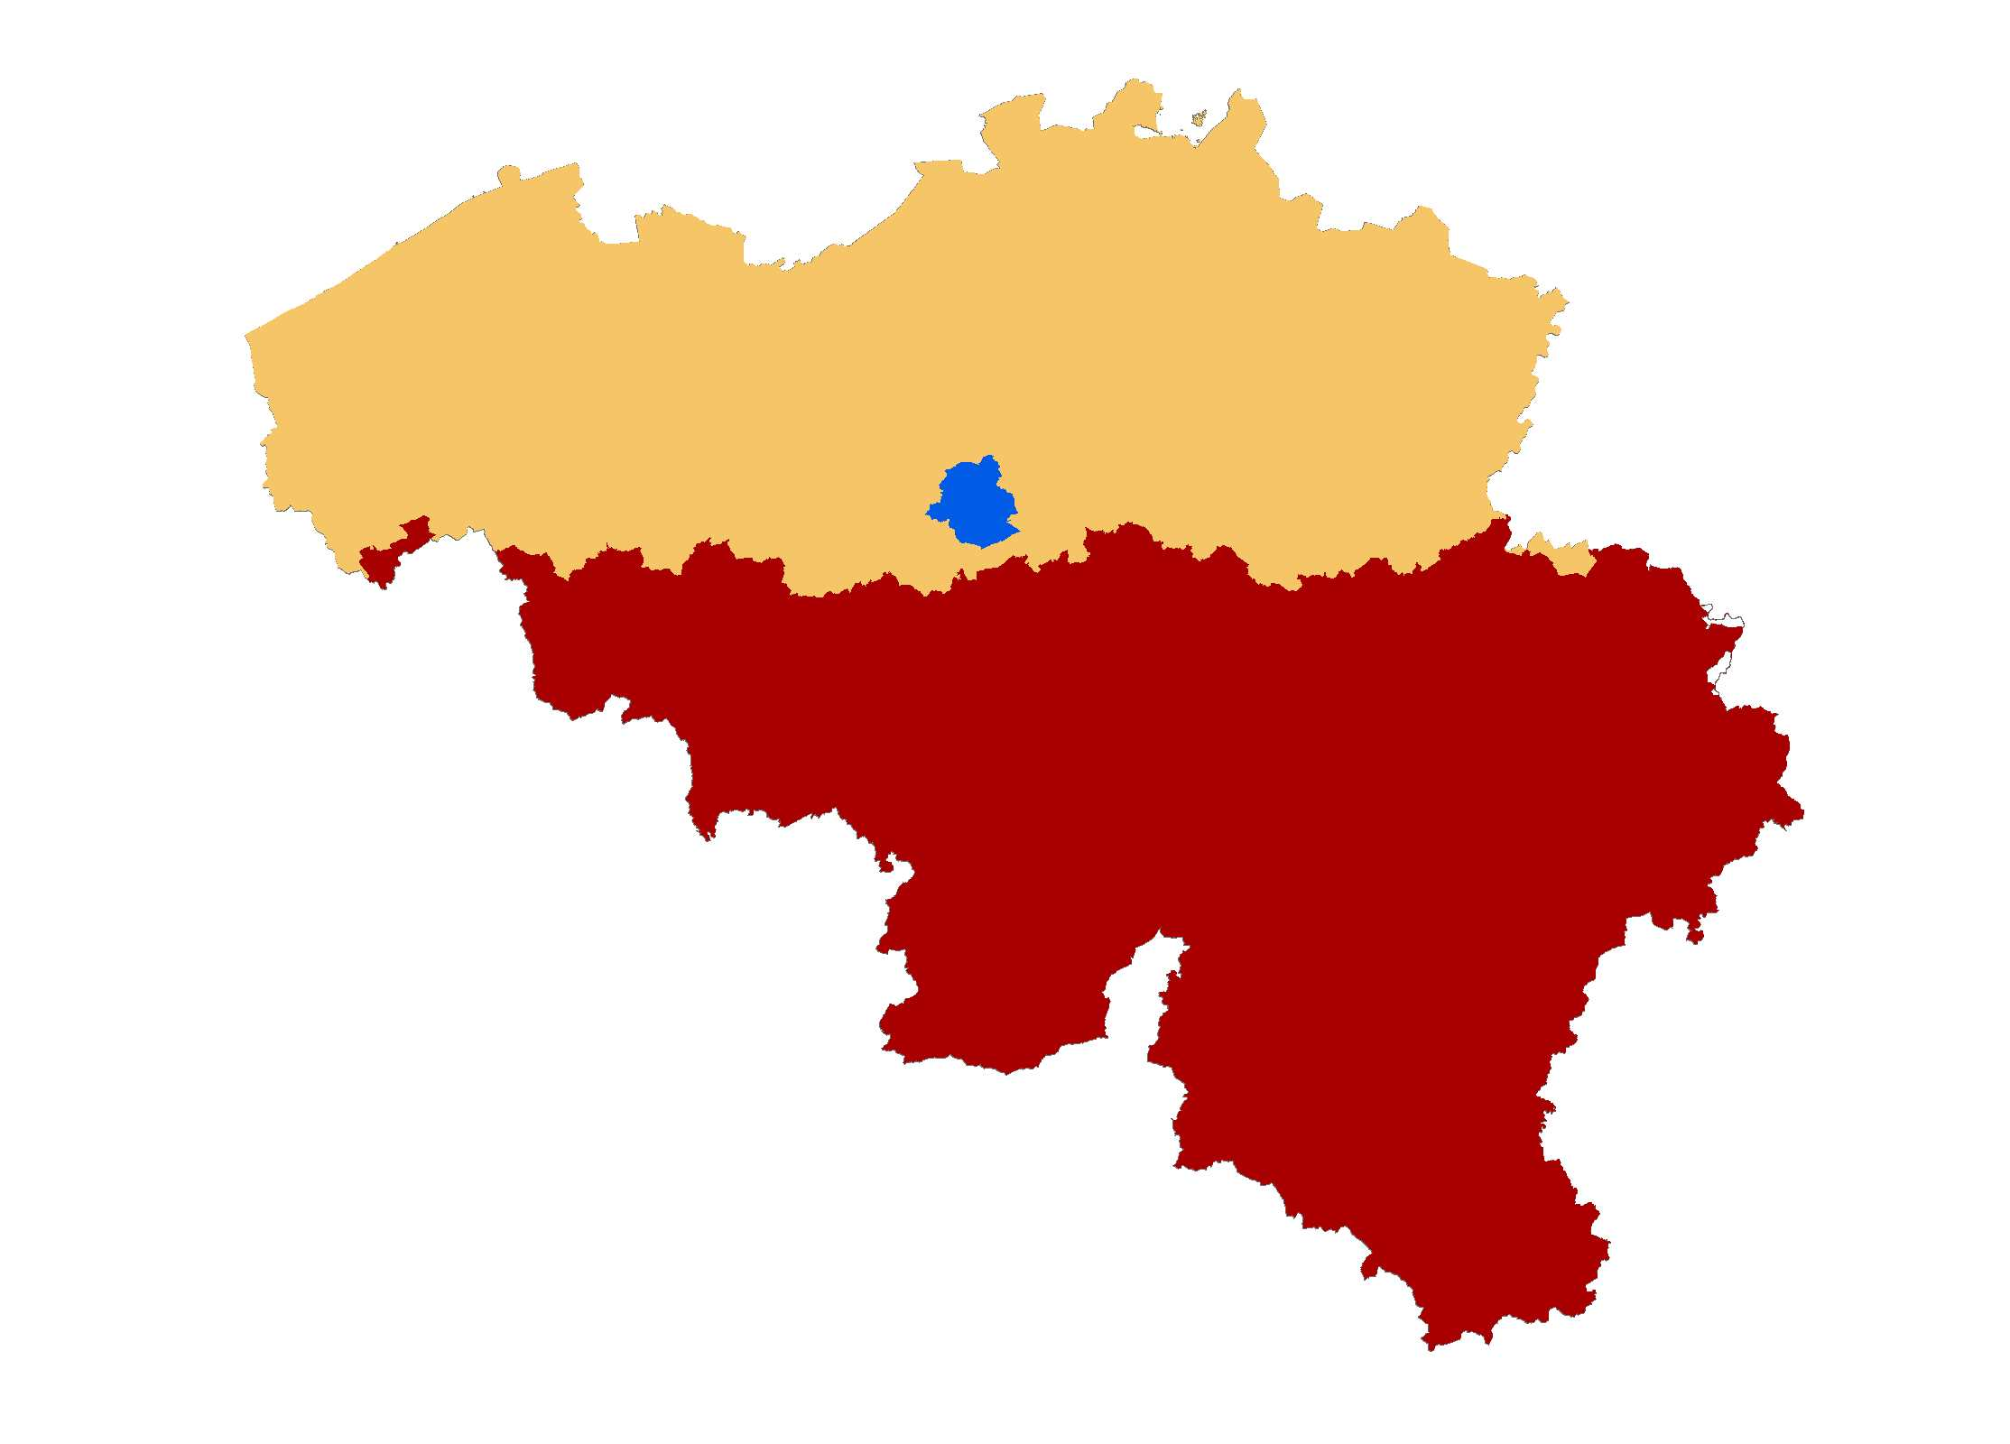
Belgian Cadastre: context
Federal level
Flanders
Estate and mortgage duties
Property tax
→ partly organised at Flemish and federal level
Brussels
Power shift towards the
regions with every state reform
BUT:
Property Tax base (Cadastral Income)
→ assessed and calculated at
federal level
Wallonia

Slide 6
Belgian Cadastre: duties
Updating and correcting the cadastral plan
Measuring plots of land and buildings
Measuring the administrative borders
Developing the geographic information system
Updating the cadastral plan on the basis of the surveyors' plans
Determining the tax base such as the cadastral income in favour
of the tax authorities
Determining the capital or market value of real estate by order
of legal authorities or sister administrations
Verification of the declared value as regards the registration and estate duties
Verification of the construction value as regards the VAT

Slide 7
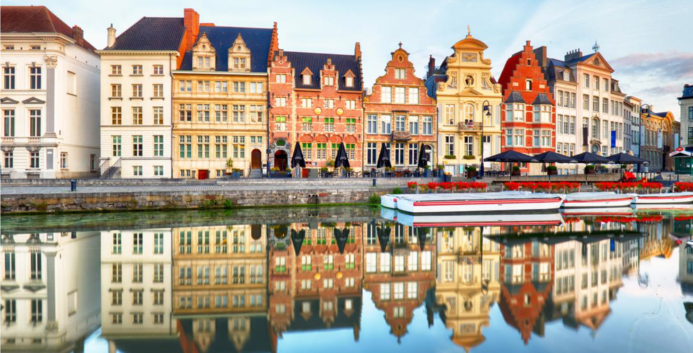
Property tax and cadastral income
Property tax: recurrent tax on real estate
Cadastral Income: tax base
  the average annual (fictitious)
  rental value of the immovable property
  net of expenses
  date of reference: 1/1/1975
  indexed since 1991
  modified building = modified cadastral income
Database with information on 9 million parcels and 7 million constructions
Buildings have a ‘construction code’
Notes:
The property tax in Belgian is an annual tax on all sorts of real estate; whether it is land or a construction, whether it used for residential or commercial purposes, for industrial or agricultural use. They are all taxed (assessed) on the same basis; the cadastral income. The cadastral income is the average annual rental value of a property reduced by 40% for acts of maintenance. The cadastral income is the rental price which the tax payer is deemed to obtain when renting the immovable property. An immovable property should not actually be rented in order to have a CI. Not only buildings have a CI, but also land and material and equipment.
Because of the outdated character of the cadastral income (based on values of 1975), our administration is encouraged by the public opinion, as well as European authorities (OECD e.g.), to rework this property tax base or to move towards a new valuation method.
Information on buildings is called the ‘construction code’, which consists of 14 terms that represent the lay-out of a construction (sort of property e.g. villa, mansion,..) ground surface, usable surface, number of rooms, terraced house, detached, heating, number of bathrooms, last renovation, …)

Slide 8

Digital cadastral plan - CADGIS
One continuous digital plan based on the digitalisation of tons of papers
An open data fiscal situation (1st January)
One tool, many users & many uses (from the citizen to the expert)
  Ask an extract of the documentation
  Divide a plot of land
  Improve the quality of the plan
  …
Integration of partner services
  Buildings managed by the regions
  …

Slide 9
Digital cadastre - STIPAD
A transversal platform between Cadastre and Legal Security
Measurements and Assessments (Cadastre)
  Defines, describes and valuates
Legal Security
  Identifies who owns a property as defined by M&A and for which period
  ➔ Working together to improve the citizen’s trust

Slide 10
Precadastration (since 2015)
  1 Principle :
  Every building, apartment or plot of land must
  be identified and sketched on the plan
  before every transaction
  Why?
  Need to have a correct definition of the object that
  will be owned
  How?
  The parcel is…
  already identified ➔ No problem
  A part of an existing parcel or building ➔ Precad in partnership with Notary & surveyor before the deed
Notes:
The precad able us to be a reference as provider of identity of owner but also of the definition of every real estate. Before the Precad, Notary or people should sell and buy real estates in a deed saying : « I sell you a part of 10m² from my backyard » that was obviously difficult to know what was really the property of each other after this transaction and it was really difficult to make a cadatration of the nieuw plot of land. Now, we need to exactly know what will be sold and the Notary has 2 option: The parcel is….

Slide 11
Precadastration
Notes:
Precadastration vue from the screen of our agent and Precad based on surveyor’s plan seen in the previous slide

Slide 12
Future challenges
Develop new valuation tools
Further automation of our systems and processes
  Internal processes
  Shared processes (Precad online…)
Making a transition towards a new property tax base
  Self-regulating system
  Computerized valuation method based on econometric valuation models
  Fair system which reflects the current situation on the housing market
Towards an open data Cadastre
Sharing data with the regions and other partners
Notes:
Computerized valuation method which takes into account certain intrinsic characteristics of a property, such as the usable surface, luxury elements, but also and especially the location of a good.
In the spirit of open data, we want to develop platforms for our partners and the citizens providing them with all cadastral information on immovable goods, namely information on the cadastral parcel, as well as the value of each property. This system will be likely to get more acceptance from citizens as they will better understand how the value of their property is calculated and therefore will lead to less appeals.

